Slide 1
What is IoT???

Slide 2
Internet of Things
The Internet of Things is the network of physical object with unique identifiers that are connected with each other and are embedded with electronics, software and sensors which enables these objects to collect and exchange data.

Slide 3
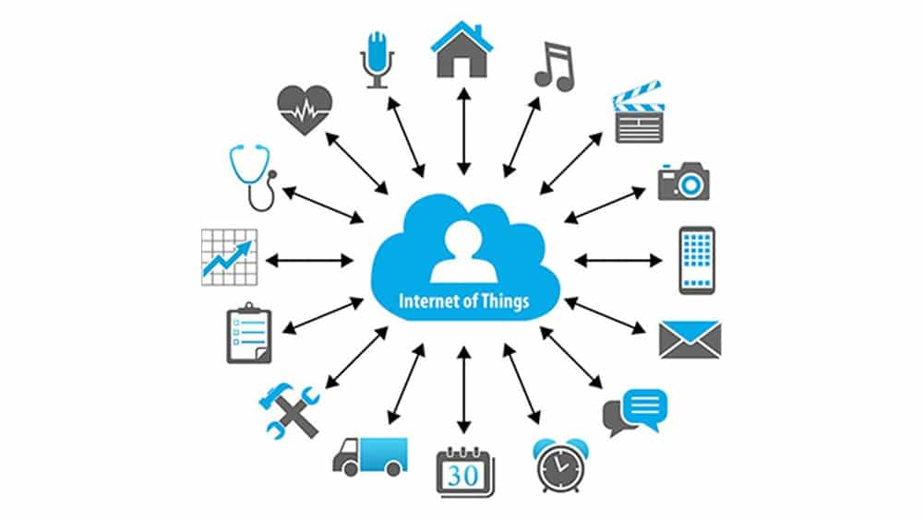

Slide 4
The revolution brought by IOT.

Slide 5
Healthcare
Manufacturing
Transportation
Analytics and cloud computing
Smart Home

Slide 6
IoT technology
Arduino
raspberry Pie

Slide 7
Introduction of Arduino
Arduino is an open-source electronics platform based on easy-to-use hardware and software. Arduino boards are able to read inputs - light on a sensor, a finger on a button, or a Twitter message - and turn it into an output - activating a motor, turning on an LED, publishing something online.

Slide 8
Introduction of raspberry pi.
Raspberry Pi is a small single board computer. By connecting peripherals like Keyboard, mouse, display to the Raspberry Pi, it will act as a mini personal computer.
Raspberry Pi is popularly used for real time Image/Video Processing, IoT based applications and Robotics applications.
Raspberry Pi is slower than laptop or desktop but is still a computer which can provide all the expected features or abilities, at a low power consumption.
Raspberry Pi Foundation officially provides Debian based Raspbian OS. Also, they provide NOOBS OS for Raspberry Pi. We can install several Third-Party versions of OS like Ubuntu, Archlinux, RISC OS, Windows 10 IOT Core, etc.
Raspbian OS is official Operating System available for free to use. This OS is efficiently optimized to use with Raspberry Pi. Raspbian have GUI which includes tools for Browsing, Python programming, office, games, etc.
We should use SD card (minimum 8 GB recommended) to store the OS (operating System).

Slide 9
Raspberry Pi is more than computer as it provides access to the on-chip hardware i.e. GPIOs for developing an application. By accessing GPIO, we can connect devices like LED, motors, sensors, etc and can control them too.
It has ARM based Broadcom Processor SoC along with on-chip GPU (Graphics Processing Unit).
The CPU speed of Raspberry Pi varies from 700 MHz to 1.2 GHz. Also, it has on-board SDRAM that ranges from 256 MB to 1 GB.
Raspberry Pi also provides on-chip SPI, I2C, I2S and UART modules.
There are different versions of raspberry pi available as listed below:
Raspberry Pi 1 Model A
Raspberry Pi 1 Model A+
Raspberry Pi 1 Model B
Raspberry Pi 1 Model B+
Raspberry Pi 2 Model B
Raspberry Pi 3 Model B
Raspberry Pi Zero

Slide 10
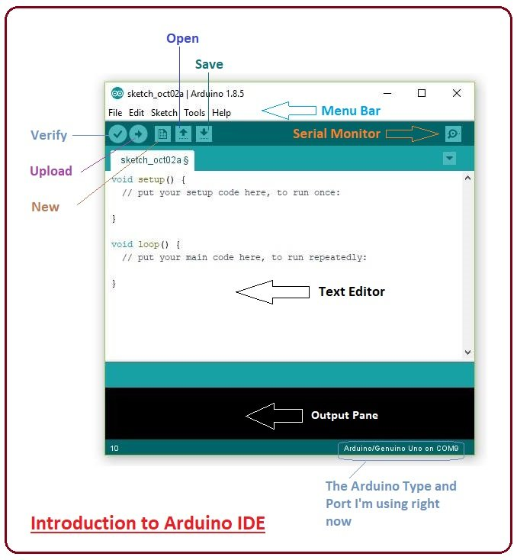
Introduction of Arduino IDE
Arduino Editor

Slide 11
Introduction of Arduino Environment

